Slide 1
TEI Architectural Overview
Sept 6, 2006

Slide 2
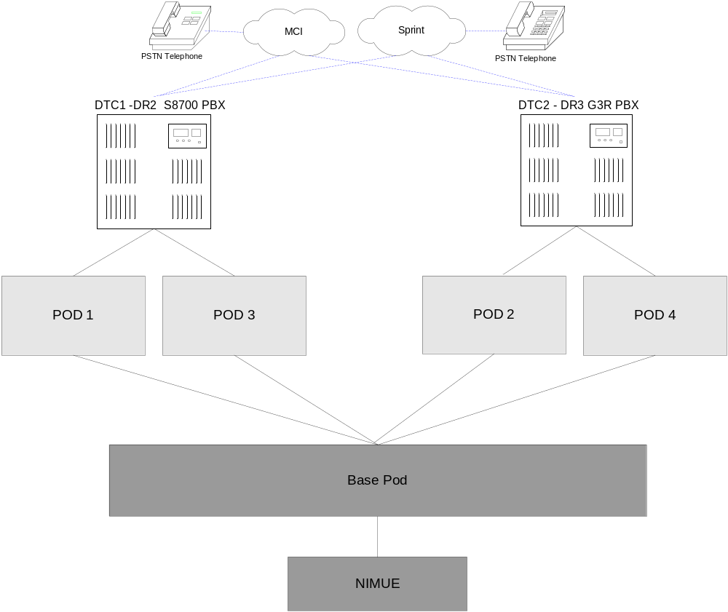
Production High Level – DTC

Slide 3
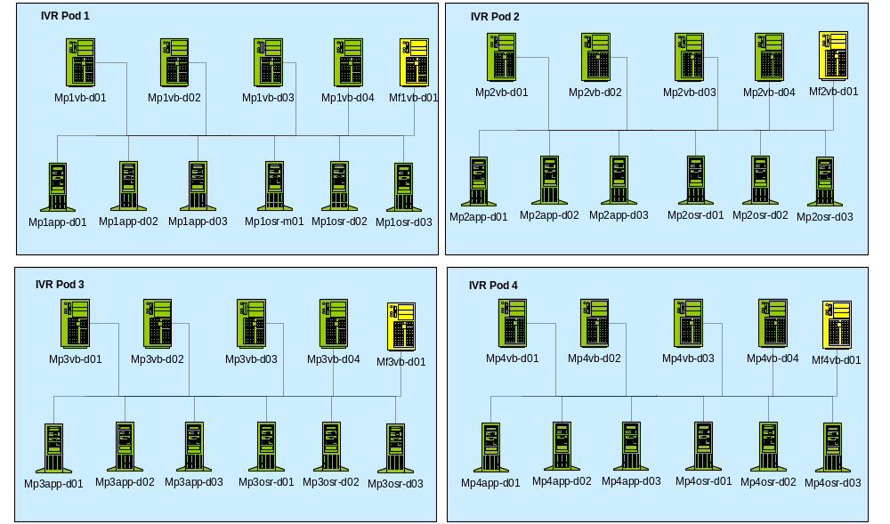
Production Detailed - DTC

Slide 4
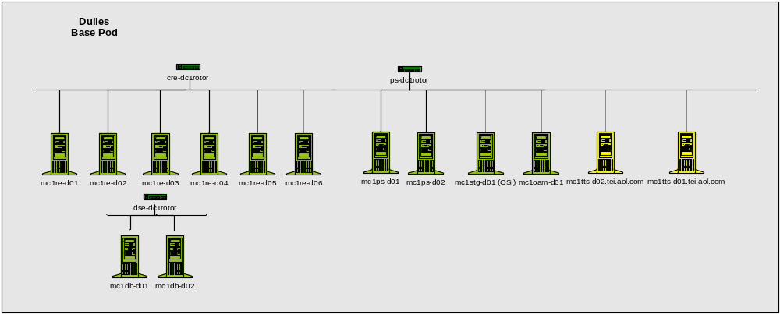
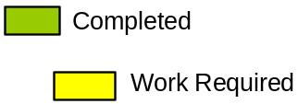
Production Detailed - DTC

Slide 5
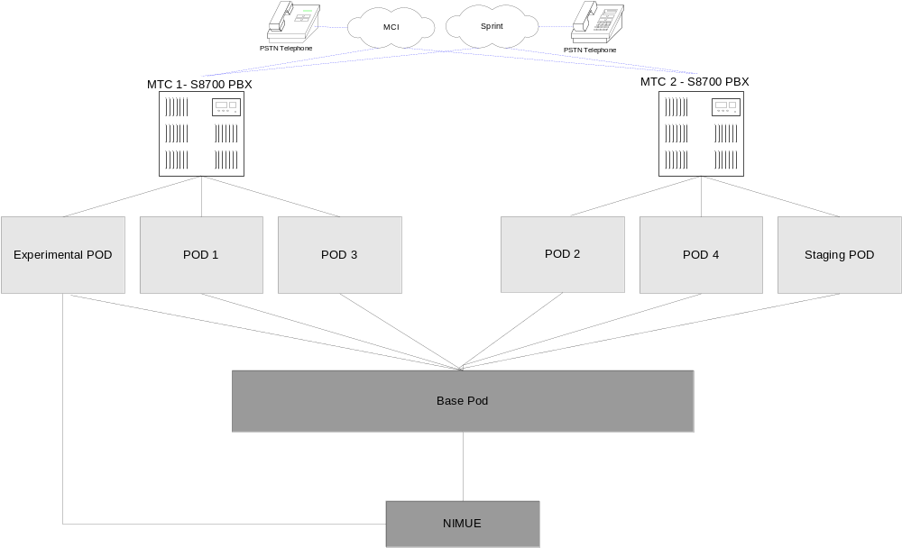
Production High Level - MTC

Slide 6
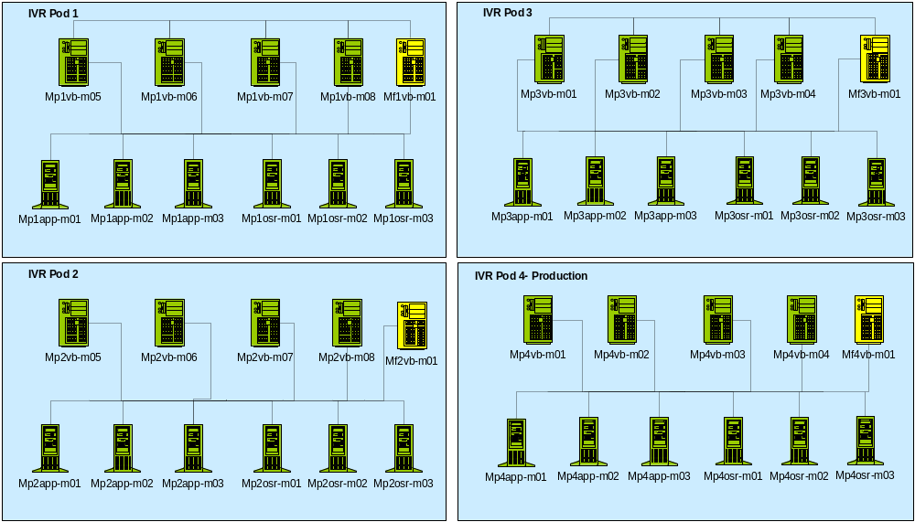
Production Detailed - MTC

Slide 7
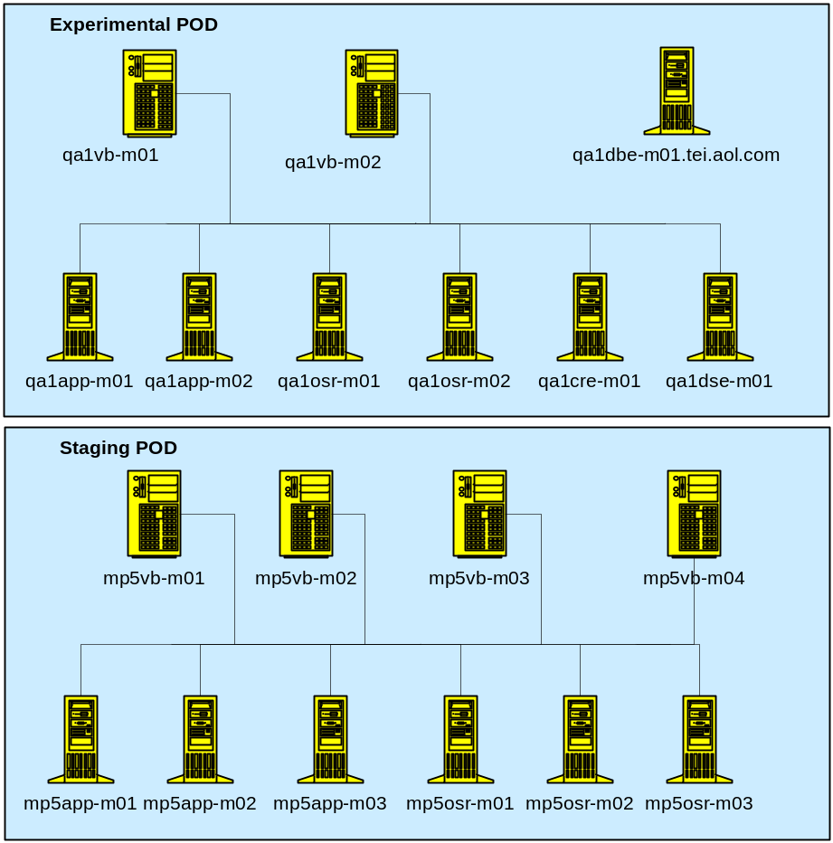
Production Detailed - MTC

Slide 8
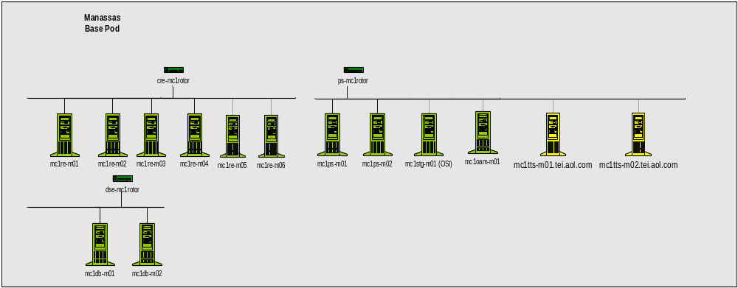
Production Detailed - MTC

Slide 9
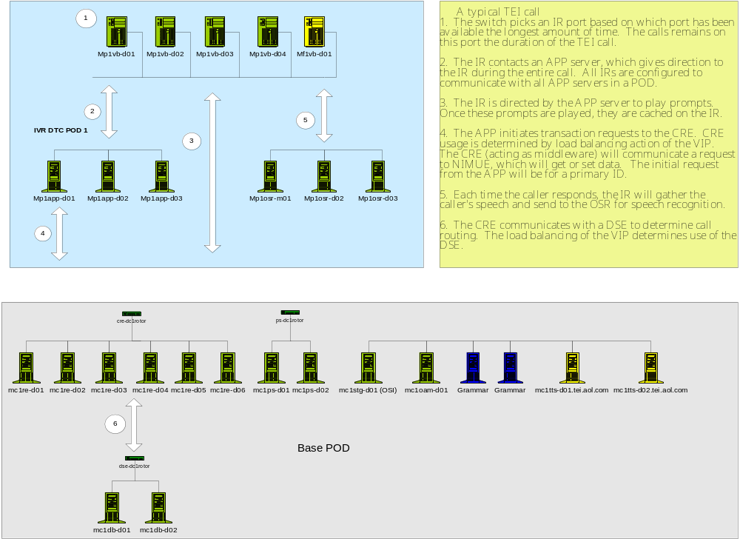
Production Call Detail

